Slide 1

On-Chip communication
Talha Ahmed

Slide 2
Trends in SoC designs
Billion transistor chips are being made, whereas only a few years ago integrated circuit transistor counts were in the millions.
Such single chip ICs are known as System on Chip (SoC).
Demand of SoCs in smart phones, cameras, game stations etc.
Multi Processor System on Chip (MPSoC).

Slide 3
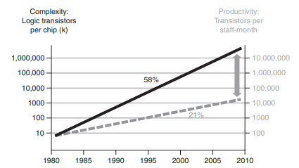
Coping with SoC design complexity

Slide 4
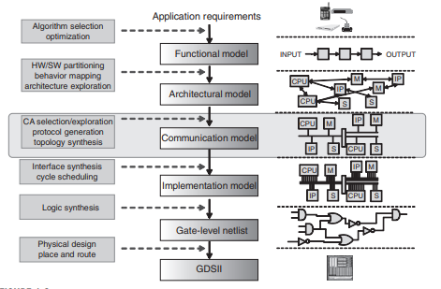
ESL Design Flow

Slide 5
On-Chip Communication Architectures
It is used for communication between devices in SoC.
It creates an architecture on which devices send and receive data or signals.
Bus
A collection of wires to which one or more IP components which need to communication data with each other are connected.

Slide 6
Bus Based On-Chip Communication Architectures
Hierarchical Bus
Ring Bus
Ad-hoc Bus
Bus Matrix

Slide 7
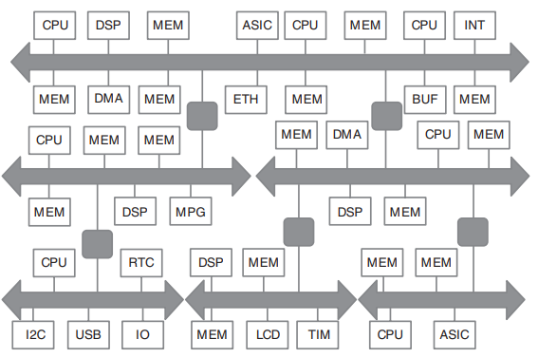
Hierarchical Bus

Slide 8
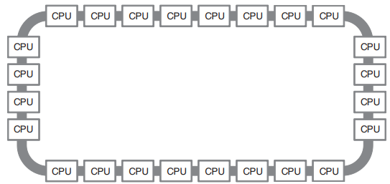
Ring Bus

Slide 9
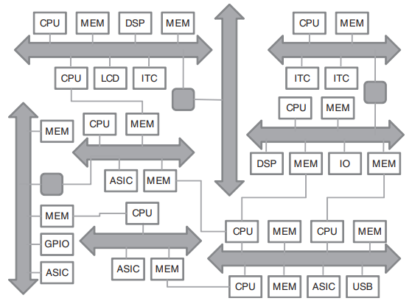
Ad-hoc Bus

Slide 10
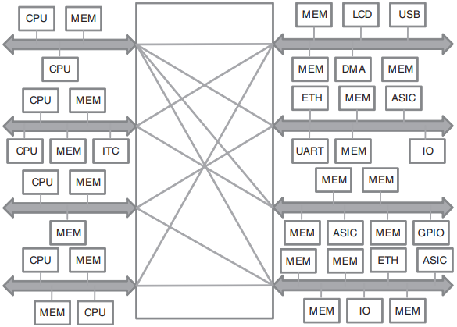
Bus Matrix

Slide 11
Bus Terminology
Master
Slave
Arbiter
Decoder
Bridge

Slide 12
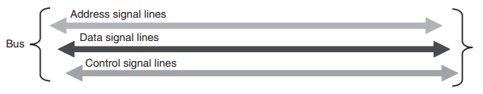
Bus Signal Lines
Bus consists of three types of signals.
Address
Data
Control

Slide 13
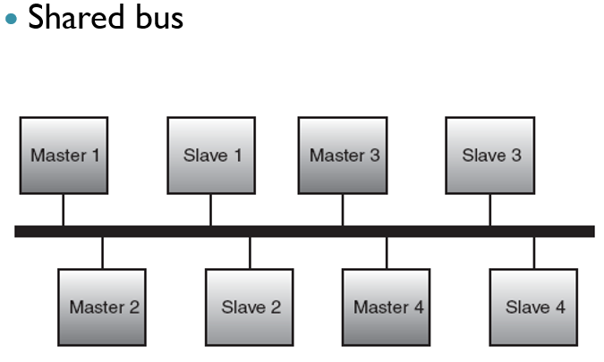
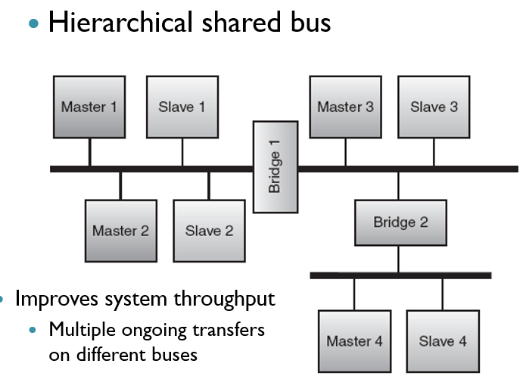
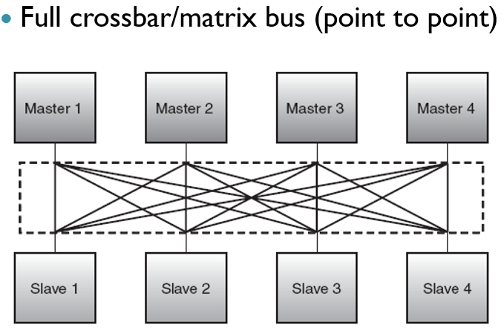
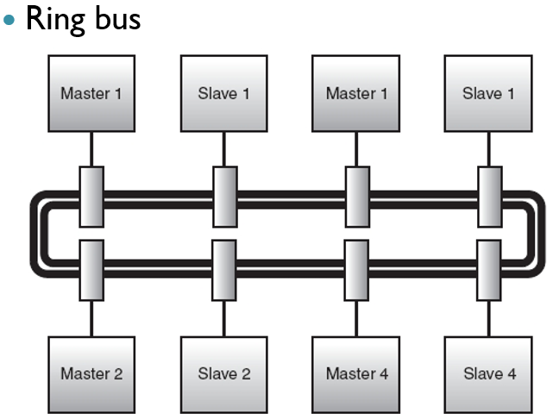
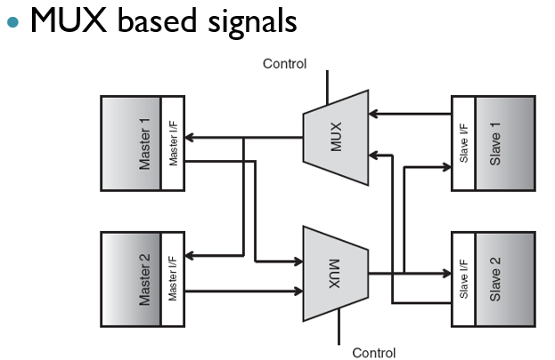
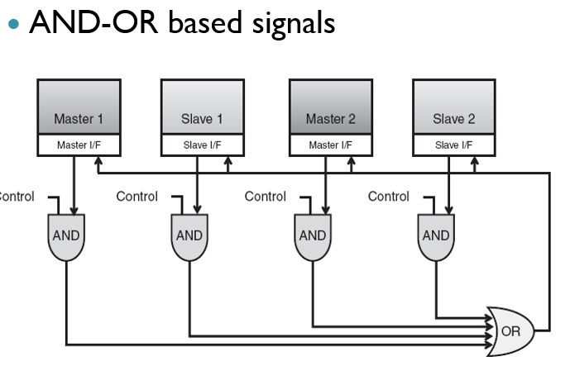
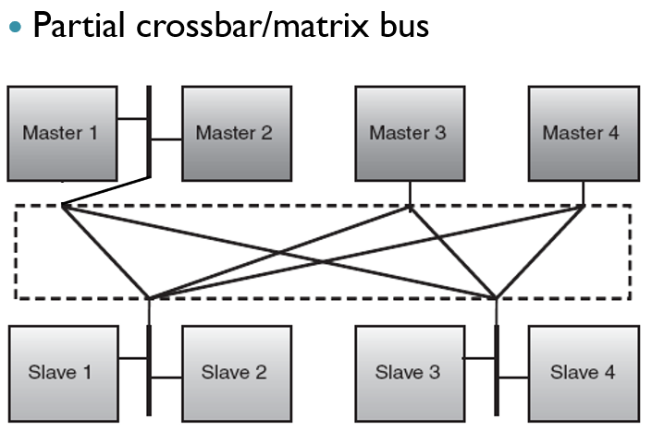
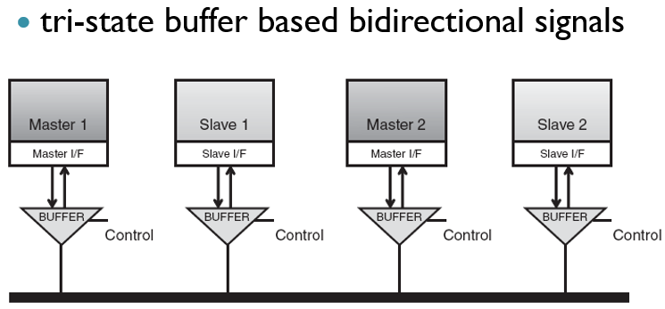
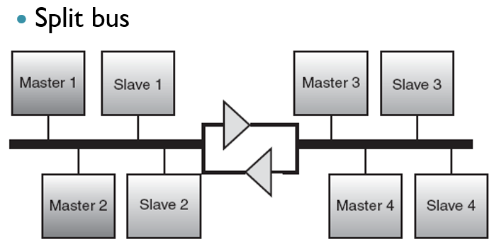
Types of bus topologies

Slide 14
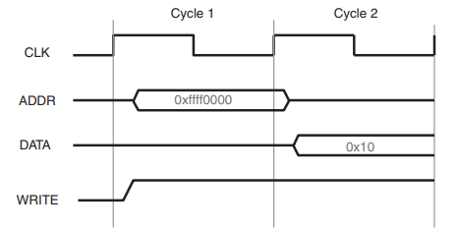
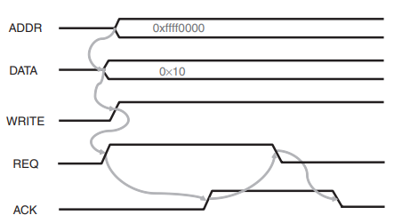
Clocking Synchronous Bus / Asynchronous Bus
Requires Frequency Converter
Simple to implement
Runs very fast
Requires Handshaking Protocol
It needs extra signal lines
Runs not as much fast as clocked

Slide 15
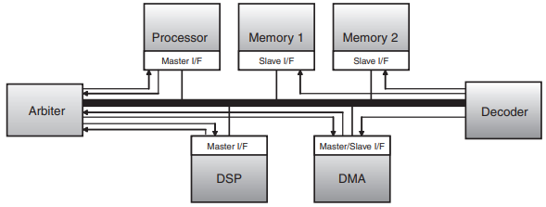
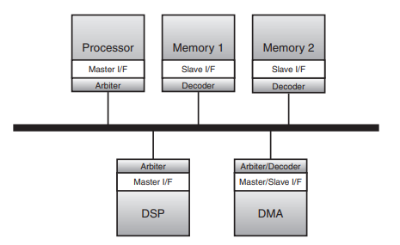
Decoding Arbitration
- Centralized
- Distributed

Slide 16
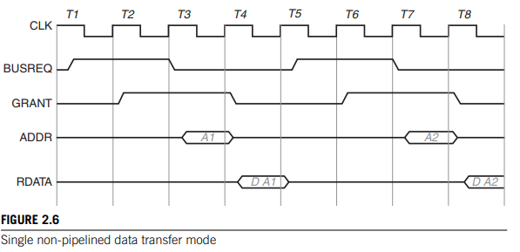
Bus Transfer Modes

Slide 17
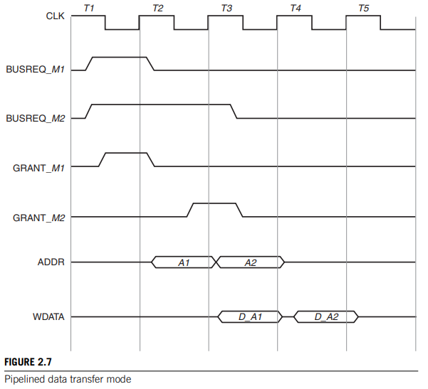
Bus Transfer Modes

Slide 18
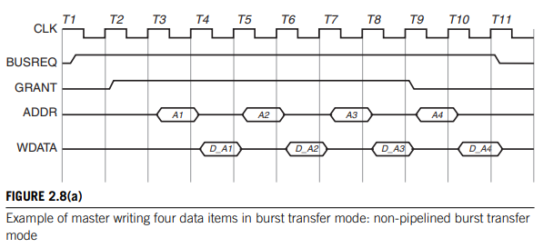
Bus Transfer Modes

Slide 19
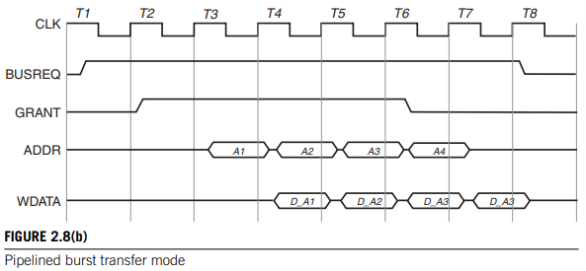
Bus Transfer Modes

Slide 20
Bus Transfer Modes
Split Transfer
Out of order transfer
Broadcast transfer

Slide 21
Arbitration Schemes
Random
Static Priority
Round Robin (RR)
Time Division Multiple Access (TDMA)
TDMA / RR
Dynamic Priority
Programmable Priority

Slide 22
On-Chip Communication Architecture Standards
System-on-chip (SoC) designs typically have several different types of components such as processors, memories, custom hardware, peripherals etc.
Each of these components has an interface to the outside world consisting of a set of pins that are responsible for sending/receiving addresses, data, and control information to/from other components.
The choice of pins at the interface is governed by the particular bus protocol of the communication architecture.
In order to seamlessly integrate all these components into an SoC design, it is necessary to have a standard interface definition for the components.
Without a standard interface definition, the component interfaces will not be compatible with the bus architecture implementation, and consequently will not function correctly.
A communication architecture standard defines a specific data transfer protocol, which in turn decides the number and functionality of the pins at the interface of the components.

Slide 23
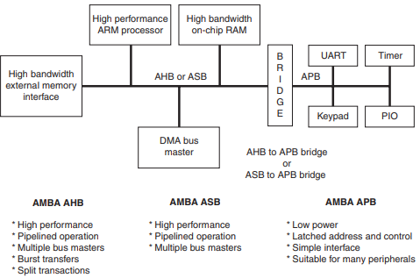
AMBA 2.0
- AHB
- ASB
- APB

Slide 24
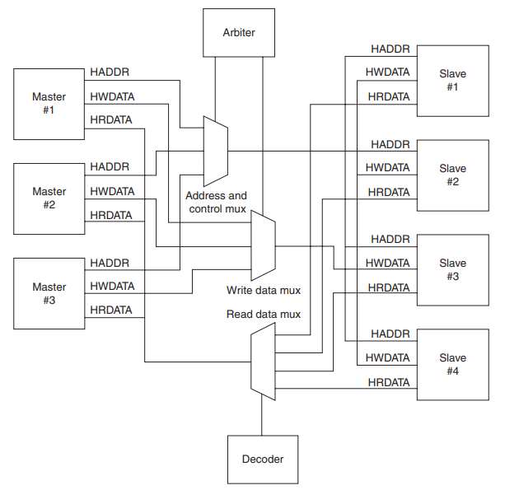
Advanced High-Performance Bus -AHB

Slide 25
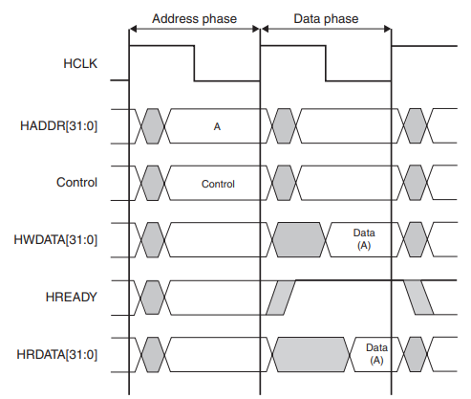
Basic Data Transfer on AHB Bus

Slide 26
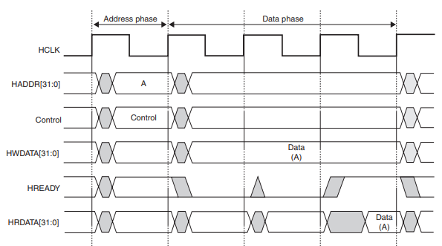
Slave Wait State in AHB Bus

Slide 27
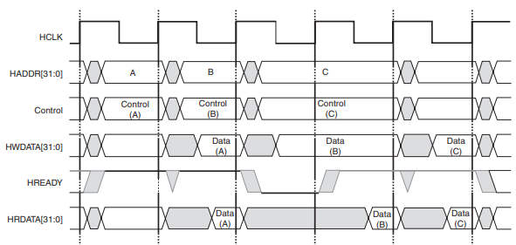
Pipelined Data Transfer in AHB Bus

Slide 28
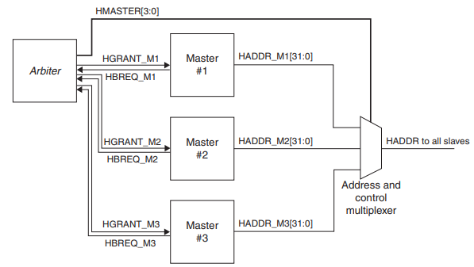
Arbitration on AHB Bus

Slide 29
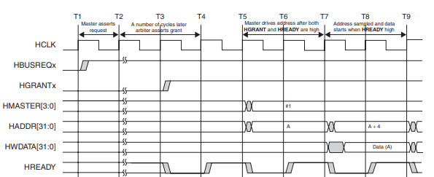
Arbitration on AHB Bus (Cont.)

Slide 30
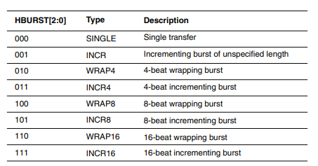
Burst Modes in AHB
HBURST signal to indicate the size of a burst data transfer.
Incrementing bursts (INCR, INCR4, INCR8, and INCR16) access sequential locations, and the address of each transfer in the burst is simply an increment of the previous address.
In wrapping burst if the start address of the data transfer is not aligned to the total number of bytes in the burst, then the address of the transfers in the burst will wrap when the boundary is reached.

Slide 31
Control Signals of AHB
HCLOCK {Clock}
HWRITE {1 bit signal by master}
HSIZE [2:0] {Size of transfer data}
HTRANS [1:0] {NONSEQ, SEQ, IDLE, BUSY}
HRESP [1:0] {OKAY, EORROR, RETRY, SPLIT}
HPROT [3:0] {Protection} (Opcode Fetch, Privileged, Bufferable, Cacheable)

Slide 32
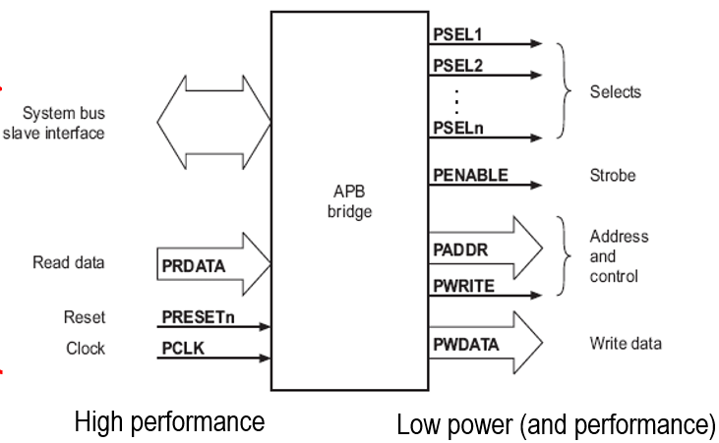
AHB – APB Bridge

Slide 33
AMBA 3.0
AXI4
Supports separate channels for:
Read and Write Address
Read and Write Data
Write Response
Out of Order support.

Slide 34
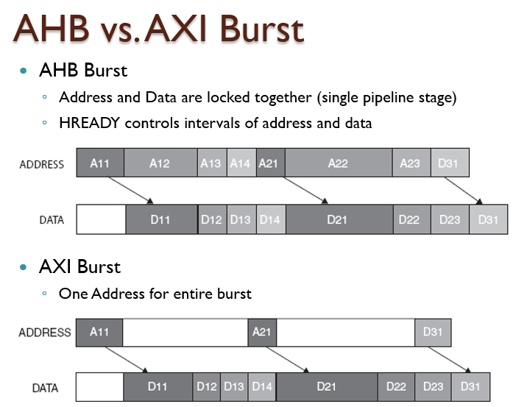
AMBA 3.0

Slide 35
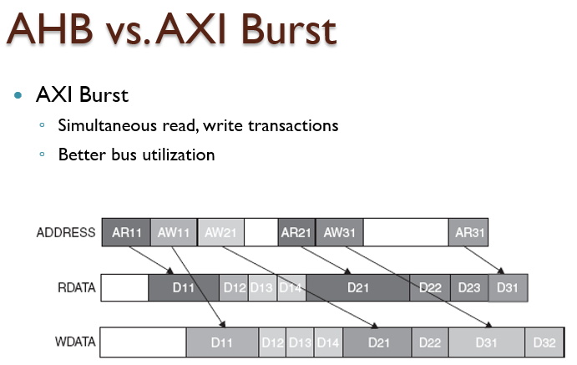
AMBA 3.0

Slide 36
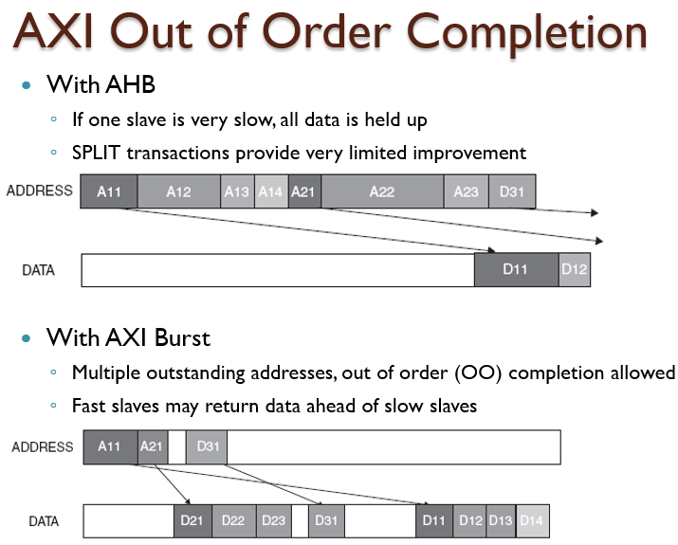
AMBA 3.0

Slide 37
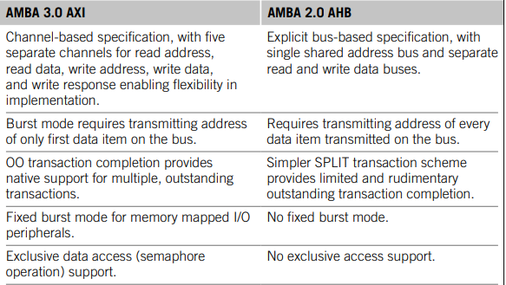
Contrasting Features of AMBA 3.0 and AMBA 2.0

